Slide 1
Getting Started with Scrum
Week 3

Slide 2
Week 2 Summary: Running a pilot study
Steps in running a pilot study
Form the team
Figure out what you want to pilot
Do a small piece of it, completely
Evaluate what you want to do next
Assess what can be improved and do it
Continue iterating steps 3-5 until satisfied
Notes:
Before starting, figure out what you will do if the pilot fails. How much time and money are you willing to sink into the process? What will you do if the pilot succeeds? Will you move directly to empirical based methods, or do you need to ease into it gradually?

Slide 3
SCRUM - Incremental process
Scrum at the project level
This approach is taken “when necessary” (from the Latin pro re nata, or PRN, which means “take when needed”). It is used, for example, when someone requires software within 30 days or less.
how to implement Scrum at the project level with minimum overhead and the quickest results.
Scrum at the capability level
A software studio is created separate from the rest of the organization.
tasked with creating competitive advantage using Scrum.
operates with a high degree of autonomy and is unhampered by bureaucracy.
as the benefits from Scrum become apparent, the studio’s use will increase
Scrum at the enterprise level
The learning from the software studio is extended into the entire organization, to its overall productivity and agility.
Covering how to use Scrum to implement Scrum
how to distinguish between talking the Scrum talk and walking the Scrum walk.

Slide 4
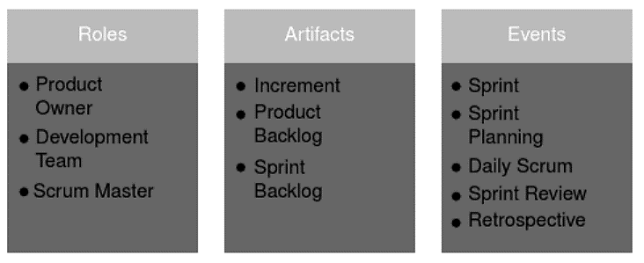
Scrum is a framework for managing complex work. It consists of Roles, Artifacts, and Events (aka rituals)
Notes:
Note: “events” are also known as “rituals”

Slide 5
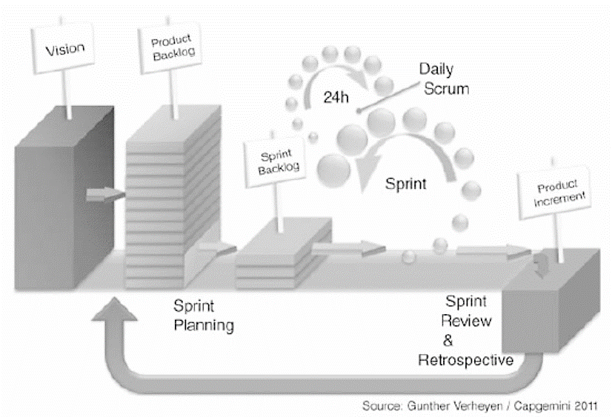
Here is the overall process
Notes:
Note: we are conducting the “vision” as a pilot study.

Slide 6
Scrum Framework Roles
Scrum Master

Slide 7
All roles are equal in Scrum

Slide 8
Scrum Team - Scrum Master
find developers to form the Development Team
glue that ties a scrum team together
no authority over others
discussions about individual roles and duties
may be a part of the development team
may not be involved in the day-to-day development
focused on development team
servant leader

Slide 9
Scrum Master - Responsibilities
Some critical rituals that a scrum master must observe (more details later)
the daily standup
the sprint planning meeting
the end-of-sprint demo
the sprint retrospective

Slide 10
Scrum Master
host daily is the fifteen-minute stand-up with the entire team, and any guests
involved in several follow-up discussions at the end of the stand-up
removing blockers from team members who cannot move forward without coordinated assistance
meet with constituents (product owners and team members) to follow up on any other issues that were raised during the standup
ensure time constraints are honoured

Slide 11
Scrum Master
Updating the artifacts of scrum – daily duty
allows anyone to see at a glance what the team is working on, to support the essential transparency that keeps scrum working.
calculating and reporting on team metrics such as velocity, and clarifying the relevance of these concepts to people outside the team
recognize issues when they manifest
coach the team when issues arise
preparing reports on the team's status in plain language

Slide 12
Product Owner
has a shared responsibility to the team and to the customer
voice of the customer
stands in as the representative of the customer's needs, wants, and expectations
usually belongs to a department such as Product or Customer Support
spends time working with customers directly to understand their needs
translate these into clear descriptions that the team can estimate and work on, using a consistent format we call stories in scrum terminology

Slide 13
Product Owner
keeps an eye on the big picture from the customer's perspective
looking at the overall state of the product and the timeline for release cycles
the changing technical landscape, while deciding what features are the highest
priority for the team to work on in the next sprint

Slide 14
Product Owner
work with designers to make sure user experience flows have been considered, and that design assets are ready for the team.
work with QA engineers to verify that the necessary acceptance criteria are accounted for in the test suite for a story.
collaborate with the scrum master to help remove blockers from outside the team
works closely with the team to decide
if desired feature is technically achievable, given the practical constraints of the team and the technology
to plan out the sequence of stories based on their historical development velocity and their feedback about the product
close to the team is vital
so developers can ask about details of a story and confirm the progress of their work.
usually attend all of the scrum rituals.

Slide 15
One Person Should Not Be Both Scrum Master and Product Owner
Product owner has a duty to the client or customer first
usually isn't part of the engineering department.
Scrum master
center around sustainable productivity
may not align with the organizational objectives of anyone reporting outside the department.

Slide 16
Product Owner - Responsibilities
clarifying the needs of the customer
developing a backlog of product features to work on
writing clear stories that communicate the full expectations for the product
meeting the standards of the team
well-written story encapsulate
the full intention for a distinct slice of functionality,
any acceptance criteria
customer's justification for needing this particular feature
product owner and the scrum master will collaborate to make sure each story is ready for the team

Slide 17
Product Owner - Responsibilities
diligently working on stories that may be needed
keeps track of stories
organizes them to make sure the sequence of development is planned out efficiently and to the expectations of the customer
if the team runs out of work in the current sprint
outlining and drafting items that reflect the customer's anticipated needs for sprints in the near future

Slide 18
Product Owner - Responsibilities
doesn't need to do detailed planning more than a sprint or two ahead
stories written too far in advance are so frequently discarded or rewritten
usually a waste of time to spell them out in much detail.
maintains a vision for how the product will evolve as individual features
keeping in mind the importance of setting the stage in the current sprint for features that may be needed in the future

Slide 19
Product Owner
like to attend the team's daily standup ritual
generally not permitted to ask questions or give feedback until after every member of the team has presented, unless asked directly
will often follow up on issues that were raised during the standup with the relevant parties, either on the team or outside.

Slide 20
Product Owner
constantly watching team progress
prerogative to adjust the order of the stories in the current sprint if it appears that a critical functionality is in danger of not being completed soon enough.
prioritize the backlog of stories that are ready for the team to start work on if they run out of stories in the current sprint

Slide 21
Product Owner
ready to answer questions about the stories that are in progress during the sprint.
is in daily communication with the customer to report on progress and get insight into any issues that may be on the customer's mind
Writing and refining stories for the next sprint
grooming the backlog of stories to meet the customer's vision for the product
working with designers to make sure that everything the team will need to work on for these stories will be ready for them

Slide 22
Development Team
teams consist of a set of four to eight engineers
skilled at decomposing big requirements into small actionable things that they can develop in a Sprint.
estimate the effort to develop the requirements into completed software functionality.
Because they will be doing the work, they should make the estimates.
accuracy depends on
how long the developers in the team have worked together
how well they understand the technologies involved
how well they understand the business or problem domain
When the planning is complete, the developers forecast what work they believe they can do by the end of the Sprint.

Slide 23
Development Team - Pair Programming
engineers to work together
matching people with different levels of experience to work together on the same code, so each can benefit from the perspective of the other
knowledge is shared across the entire team
what the product is doing
how to develop every part
silos of information that reside only in the head of a single engineer are discouraged
may appear to go a little slower
But deeper shared context will develop

Slide 24
Development Team - Responsibilities
quality of the product being developed
supported by the team's ability to accept or reject stories
If stories aren't fully clear, or that may be impossible/impractical given the history of the project
estimating the effort involved to complete a story
measured in arbitrary points, is assigned by the team to help establish how much work they can do within a timeframe
preservation of the scrum process
push back against any attempts to sacrifice quality
tracking the overall quality of the codebase
proposing stories that would refactor the existing code to enhance maintainability

Slide 25
Development Team - Responsibilities
preservation of the scrum process
anyone interrupts the standup or tries to introduce changes to a story in the middle of a sprint, every team member should feel authorized to interrupt that behaviour
failing to defend the scrum process is letting the other team members down

Slide 26
Scrum Events (aka Rituals)
face-to-face gathering in real time
targeted communication with each other
favours communication over documentation
NOT ANOTHER MEETING
Every ritual
has a specific objective
addresses a particular audience
defined time frame

Slide 27
Scrum Rituals
scrum master
host each of the rituals
focus on their objectives
produce the desired results
everyone
Knows before the ritual starts what to expect
how to behave
what the result of the commitment is supposed to be

Slide 28
One- Week Sprint Ritual
(2) Daily Standup
Development
Daily Standup
Development
Daily Standup
Development
(3) Sprint Demo
(4) Sprint Retrospective
(1) Sprint Planning
Development

Slide 29
Sprint Planning
marks the beginning of each sprint
hosted by the scrum master
person responsible for the content that goes into a sprint planning is the product owner

Slide 30
Sprint Planning - Objective
set the agenda for the upcoming sprint
an introduction to the stories that should be completed during the next sprint.
product owner shows how the stories fit into the vision for the product
the team commits to completing as many as they believe they're capable of, given their historical velocity
determined by the number of points they've been able to complete
At the end of the sprint planning
commitment to a certain set of stories
stories should all be clear,
amount of work they represent should be within the capacity of the team

Slide 31
Sprint Planning – Preparation
Before sprint planning, product owner will have been working with designers, customers, various team members, and the scrum master to create a backlog of clear and specific stories

Slide 32
Sprint Planning – (a) Introducing New Stories
product owner goes over the stories, presenting them to the team for evaluation
Team members
participate actively
opportunity to question and challenge the completeness and appropriateness of each story

Slide 33
Sprint Planning – (b) Story Estimation
estimate the relative level of effort required to accomplish each story
based on team's experience with similar stories in the past
estimating is that the values assigned to the different stories are arbitrary and relative
bear no resemblance to actual time
to improve the team's ability to look at a new story
figure out how
much effort it'll take relative to other stories

Slide 34
Sprint Planning – (b) Story Estimation
Estimation method: Points
a smaller, easy story may be estimated at one point
a large or complex story may be assigned 20 points
get a sense of how many points they can accomplish within the single sprint
everybody on the team to agree to the point estimate for a story,

Slide 35
Sprint Planning – (c) Committing to a Sprint Backlog
Once all the stories that the product owner has presented have been estimated, all the participants in the ritual work together to come up with a backlog that makes sense for the upcoming sprint
The end product of a sprint planning is a sprint backlog that everyone on the team can agree to

Slide 36
Bugs
has a specific definition in scrum
are missed requirements for stories that are still in progress
that have already been accepted as done in a prior sprint
no points are assigned for fixing the bugs to bring the story to a done state

Slide 37
Tasks
Tasks relating to code maintenance should be included in the work done by the team, and prioritized in the sprint backlog
should not be estimated with points
usually does not deliver any tangible user value
but needs to be done
Eg
code re-factoring
infrastructure changes

Slide 38
Spikes
stories that require deeper research
not assigned points
clear and agreed outcome for each spike
the more spikes that are required to accomplish the goals of the product owner, the lower the number of points the team can accomplish in a sprint

Slide 39
Scrum Artifacts – Product Backlog

Slide 40
Scrum Artifacts – Product Backlog
stories for the development team emerge from the product owner's product backlog
product backlog keeps track of
all the input the product owner has about the direction of the product from the client,
the research,
experience testing,
design,
engineering feedback the product owner has gathered

Slide 41
Scrum Artifacts – Product Backlog
don't need to be structured in any particular way
main purpose is to allow the product owner to keep track of all of the features that are needed
items may be quite vague until they crystallize into a clear development story for the sprint backlog
always reflect the product owner's latest thinking about the long-term goals for the product

Slide 42
Scrum Artifacts – Product Backlog
there doesn't have to be a one-to-one correspondence between items in the product backlog and stories that make it into the sprint backlog
features and requirements may turn into multiple stories, or several items may be combined to create one unified story of the appropriate size and scope for development

Slide 43
Scrum Artifacts – Product Backlog - Example
if the customer needs to add a payment system to a site, that may be a single story for the development team, or it may be multiple stories
There may be developer stories around creating the ability to accept payments through a service, and separate stories for accepting credit cards, checks, or even maintaining a token system so that purchases can be made using a virtual currency. It might be possible to develop each one of these independently, and launch the system with just one
Whichever one goes out first may need to carry the weight of implementing some core functionality that all the others will share

Slide 44
Scrum Artifacts – Product Backlog
find it convenient to track the state of items in the product backlog using a staged process,
the item moves from ideation through design through engineering validation, until it's ready to be phrased as a sprint backlog story and added to an upcoming sprint.
Product owners should have a clear sense of what it takes to move an item from each of the states to the next, and that should be documented so it'll be consistent for each story.

Slide 45
Scrum Artifacts – Story - Formula

Slide 46
Scrum Artifacts - Story
how the product owner communicates to the development team what needs to be developed
describes a feature to be worked on
should capture a complete slice of functionality
independent
so that developers don't have to complete one story before working on another
small slice of functionality that can be worked on
completed over the course of a single sprint

Slide 47
Scrum Artifacts - Story
capture the essence of a feature
give the team the ability to discuss the parameters and acceptance criteria
estimating work by sizing feature stories around what the team can accomplish in a sprint
every story should add to the value of the product
bring it closer to the vision of the product owner
each story should make it clear how the product owner will test the final product to verify that the story has been completed

Slide 48
Scrum Artifacts - Story
product owner
responsibility for writing the stories
writing good story takes time to develop
critical to an effective scrum process

Slide 49
Scrum Artifacts – Story - Formula
Name: brief understandable feature name
As a type of user
I want to behavior
so that justification for the behavior
Acceptance Criteria:
Given a defined state
when a set of conditions or events
then a consistent and testable result

Slide 50
Story Example:
Name: Rating Gallery Images
As a gallery viewer
I want to rate the images
so that I can track and rank the images I've rated
Acceptance Criteria:
Given a logged-in user viewing a gallery
when the user clicks a star in a rating widget for an image
then the value of that star should be recorded as that user's rating for that image

Slide 51
Story Example (con’t)
and
Given a logged-in user viewing a gallery
when an image the user has rated is displayed
then the rating widget should reflect the user's previously entered rating
and
Given a logged-in user viewing a gallery
when the "Favorites" switch is toggled on
then only images the user has rated should be shown, in descending order of rating

Slide 52
Scrum Artifacts – Story
the team may have a standard for how wireframes or designs get attached to stories and communicated.
For example, if this is a new widget, the designer may have prepared a mockup and a set of assets that the engineers will need in order to implement the feature
There may also be a style guide or other documentation for the product that needs to be updated with the relevant information

Slide 53
Scrum Artifacts – Story
story is presented at sprint planning,
the engineers should verify that all of the necessary assets and information they'll need have been captured & are available.
The actual work to be done in the upcoming sprint is defined by the description on the story card and the dialogue it inspires between the product owner and the team.

Slide 54
Scrum Artifacts - Scrum Board

Slide 55
Scrum Artifacts - Scrum Board
tracks the progress of all the stories being worked on in the current sprint until it meets the team's definition of done
provide a focus for the entire team
anybody on the team should be able to get an immediate snapshot of where the sprint stands, and how the team is progressing toward meeting the goals it set for itself
good scrum board should be public

Slide 56
Useful Tools:
Trello - http://www.trello.com
Trello (with scrum plugins) - http://scrumfortrello.com/

Slide 57
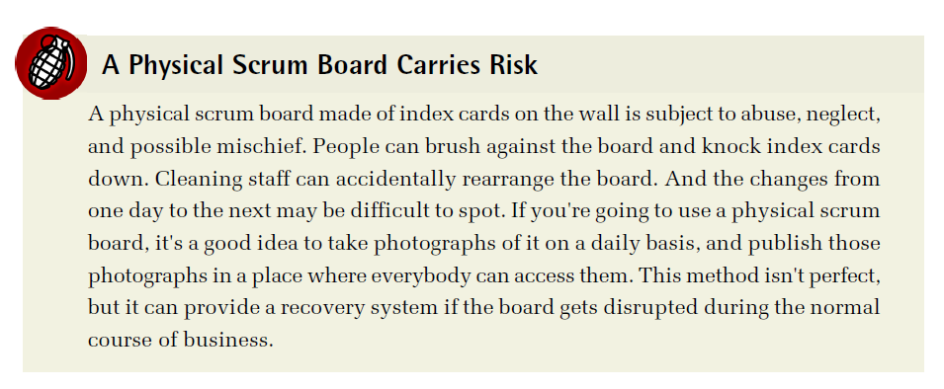

Slide 58
Scrum Artifacts – Sprint Backlog
is the set of developer stories that the team has committed to working on during the current sprint
these stories emerged from the thinking process that came out of the product backlog
may not reflect a specific item in the product backlog
size of the sprint backlog
based on the negotiations that happened during sprint planning at the beginning of the sprint
Each story has a point value, and that reflects the amount of work the team believes will be necessary to complete that particular story.
Each story point value is estimated during the sprint planning, and the backlog as a whole should represent the total number of points that the team believes it can accomplish in the upcoming sprint

Slide 59
Scrum Artifacts – Sprint Backlog
developers pick stories from the top of the sprint backlog every time that they complete a story and need something new to do
that's the one the product owner considers the highest priority in the current sprint.
Picking stories that aren't from the top of the backlog will result in work being done out of priority order.

